Slide 1
InterSystems Ensemble
A Platform for Strategic Interoperability
Notes:
Thank you. Welcome.

Slide 2
Customer Integration Requirement
What does your customer want to do?
Notes:
If you know the audience’s needs, this is the place you echo it back to them and get agreement.
If the requirement is narrow, then focus the presentation on that requirement, but make sure you let them know that Ensemble does that and a whole lot more.

Slide 3
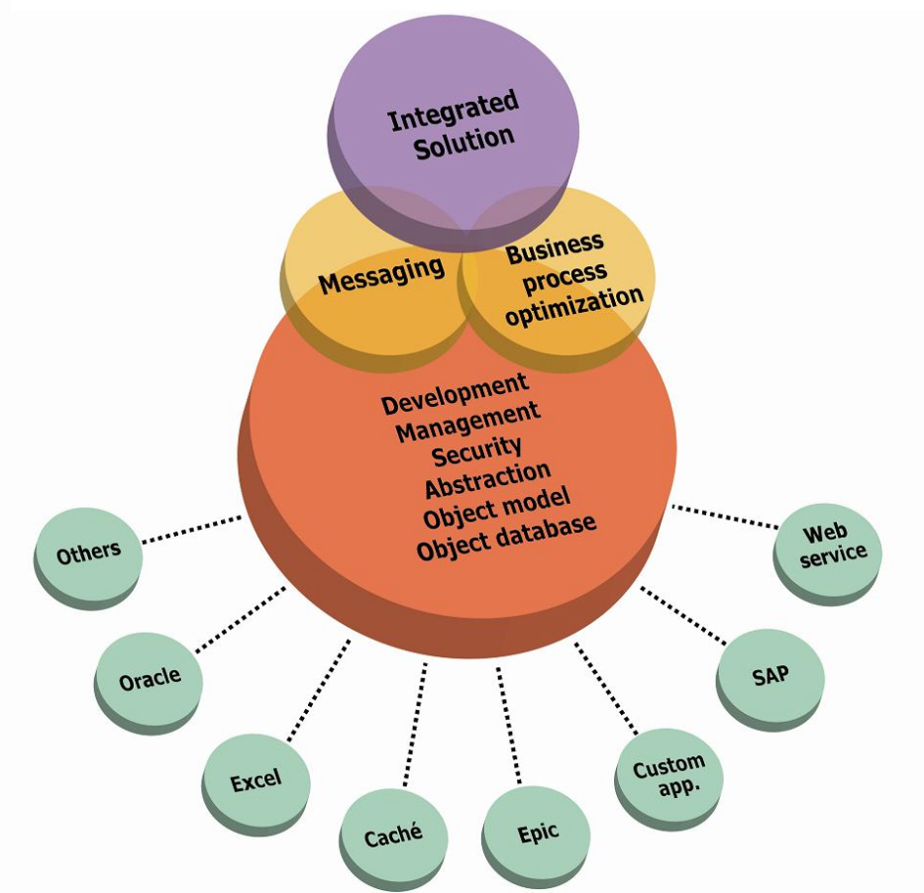
Single Business Platform
EDI
Enterprise Service Bus
Business Process Optimization
Composite Application Development
Business Activity Monitoring
Notes:
Applications all need to share information with other applications, but different models of application integration are appropriate in different situations. In many cases data integration is achieved just by passing messages or flat files from application to application to ensure data is consistent but applications run independently. Networks of applications use a message router or interface engine to transform and route messages to make the integration feasible.
In other cases, data is fed into a central repository.
In some cases data is shared between applications
With the spread of Service Oriented Architecture implementations, data and logic are not replicated but applications make real time service calls to get access to information or functionality. Here, the asynchronous interface engine is replaced or augmented by a synchronous Enterprise Service Bus.
Orchestration of synchronous and asynchronous calls to back end systems are used to automate business processes and the integration platform is now changing the way business can be done.
For application development organizations in particular, the ability to orchestrate calls to multiple systems allows you to combine information and functionality from existing systems into what appears like a brand new application. Providing a modern UI that targets specific sets of users can increase the value of the suite of applications.
A big part of delivering applications to mobile platforms is the use of Business Process Management to deliver all the information required for a task, in the correct form. To do this the Integration platform has to orchestrate calls to back end systems and merging the information to provide exactly what the user needs for the tablet display.
The final piece required in the integration platform is analytics. Analytics is needed not only to understand who is using the system, how many requests are made to each service, the responsiveness of the services etch is a basic part of the governance of the integration platform

Slide 4

Enterprise Application Integration
EDI and messaging
Data Aggregation
Enterprise Service Bus
SOA and EDA
Business Process Orchestration
Composite Application Development
Real Time Analytics
Notes:
Applications all need to share information with other applications, but different models of application integration are appropriate in different situations. In many cases data integration is achieved just by passing messages or flat files from application to application to ensure data is consistent but applications run independently. Networks of applications use a message router or interface engine to transform and route messages to make the integration feasible.
In other cases, data is fed into a central repository.
In some cases data is shared between applications
With the spread of Service Oriented Architecture implementations, data and logic are not replicated but applications make real time service calls to get access to information or functionality. Here, the asynchronous interface engine is replaced or augmented by a synchronous Enterprise Service Bus.
Orchestration of synchronous and asynchronous calls to back end systems are used to automate business processes and the integration platform is now changing the way business can be done.
For application development organizations in particular, the ability to orchestrate calls to multiple systems allows you to combine information and functionality from existing systems into what appears like a brand new application. Providing a modern UI that targets specific sets of users can increase the value of the suite of applications.
A big part of delivering applications to mobile platforms is the use of Business Process Management to deliver all the information required for a task, in the correct form. To do this the Integration platform has to orchestrate calls to back end systems and merging the information to provide exactly what the user needs for the tablet display.
The final piece required in the integration platform is analytics. Analytics is needed not only to understand who is using the system, how many requests are made to each service, the responsiveness of the services etch is a basic part of the governance of the integration platform

Slide 5
Platform for Strategic Interoperability
Data Integration
Business Process
/ Work Flow
Composite Applications
Real Time Analytics
Strategic Interoperability Platform
Data
Application
Technology
Notes:
Ensemble provides a single platform for all integration patterns.
Connecting siloes of data to give a single view of the connected enerprise allowing real time analytics on all of your data
Orchestrating calls to applications in business processes to create composite applications.
Connecting databases and technologies to share data between applications or to create a single aggregated store

Slide 6
Platform for Strategic Interoperability
Single, Coherent Integration Platform
Simplicity and Control
Rapid Application Development Environment
Consistent, Fast Integration Projects
Flexible data modeling
Handling the most complex problems
High performance
Supporting the largest enterprises
Strategic Interoperability Platform

Slide 7
Platform for Strategic Interoperability
WS
Messaging and Transformations
BPM & Workflow
Dashboards & Monitoring
Composite Application Development
Event Processing
Business Rules
Real Time BI & Text Analysis
Java
Management
Development
.NET
EJB
SQL
XML
Enterprise Service Bus
HL7
X12
High Performance Database
Internet
Local Services & Applications
Data Sources
Remote Services, Applications, Data Sources
Notes:
Ensemble provides a single platform for all integration patterns.
Connecting siloes of data to give a single view of the connected enterprise allowing real time analytics on all of your data
Orchestrating calls to applications in business processes to create composite applications.
Connecting databases and technologies to share data between applications or to create a single aggregated store

Slide 8
Platform for Strategic Interoperability
Single, Coherent Integration Platform
Simplicity and Control
Rapid Application Development Environment
Consistent, Fast Integration Projects
Flexible data modeling
Handling the most complex problems
High performance
Supporting the largest enterprises
WS
Messaging and Transformations
BPM & Workflow
Dashboards & Monitoring
Composite Application Development
Event Processing
Business Rules
Real Time BI & Text Analysis
Java
Management
Development
.NET
EJB
SQL
XML
Enterprise Service Bus
HL7
X12
High Performance Database
Internet
Local Services & Applications
Data Sources
Remote Services, Applications, Data Sources

Slide 9

OmPrompt and Kimberly-Clark
Integrated Supply Chain Automation
Multi-Tenanted Software as a Service
Kimberly-Clark, CEVA Freight, British Sugar, Avon Distribution
Kimberly-Clark
Connected in house transportation logistics systems to 100s of small to medium carriers
EDI, Paper, eMail
“integrates carriers seven times faster”

Slide 10

Northgate
Service Oriented Solution for mobile police officers
Ensemble as an ESB connecting legacy applications
Joining the dots across silos of information
Project Athena
3,000 planned users
Joining National police database to local systems
Ensemble workflow automates crime reporting

Slide 11

Mediterranean Shipping Company
2nd Largest Shipping company in the world
Agents in 270 ports
Connecting with EDI, email, RSS, SQL
Real time error detection in orders
Feedback and corrections sent to agents in time to take action

Slide 12

A new paradigm for development
Connect on-premise system to the hospital
Connect on-premise systems to the 3M cloud
Expose all legacy applications as services through the Ensemble ESB
Service oriented apps targeted at individuals, reusing legacy logic

Slide 13
Questions?

Slide 14
Data Integration

Slide 15
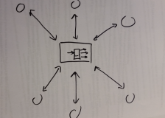
High Performance Message Routing
EDIFAC, X12, DICOM, HL7 and other protocols
MQ, JMS, http:,
Secure Message Delivery
Single Transactions or bulk transfers
Notes:
Ensemble provides a secure high performance platform for routing of synchronous and asynchronous messages. It supports a wide range of standard protocols as well as providing a development environment for proprietary protocols over a range of technologies.
The built in data store saves messages to disk and guarantees delivery of asynchronous messages even if the downstream system isn’t available.
Graphical tools make it easy for interface specialists to route and transform or map messages without s/w developers. The graphical tools for visualize the path and content of messages passing through the system make it easy to debug problems or locate completed messages.

Slide 16
Data Aggregation
High Speed Data Insertion
Files, FTP, APIs
Validation and Transformation before saving to disk
Support for complex data models
Real time analytics
Analytics for unstructured data
Notes:
Unlike other integration platforms, Ensemble includes a high performance SQL and NoSQL database. This isn’t just added on through JDBC but built into the heart of Ensemble.
This means you can ingest data from files and data streams at high speed and aggregate into the database. Ensemble supports simple name value pair data as well as complex relational and object data models. You can also store XML, JSON, Documents and other
Often this approach is taken to provide analytics on the consolidated data. This could be with Ensemble’s built in analytics tools including analytics on the unstructured data; or with external SQL based analysis engines.

Slide 17
Connectivity
Adapter library
Language bindings for Java, C++, etc.
Technology Adapters for TCP/IP, SOAP, REST, FTP, Files, SQL etc.
Protocol Adapters for standards e.g. HL7, EDIFACT, SAP BAPI etc.
Connections to other messaging networks e.g. MQ and JMS
Adapters manage the connection
Maintaining connections, Error handling, Retries
Isolate the integration logic from wire protocols
Notes:
All integration patterns start with connectivity. Ensemble provides a library of language bindings and adapters for common technologies such as http:, TCP/IP, FTP, JMS, and MQ as well as protocols such as SOAP, SQL, HL7, X12 etc. or applications like SAP.
The adapters isolate the integration logic from the details of the wire protocol, making it easy for the ESB to receive a request in one technology, such as REST and route that as an SQL query to an external database service.
As well as dealing with the protocol, the adapters do all the hard work of maintaining connections, retries and error handling.

Slide 18
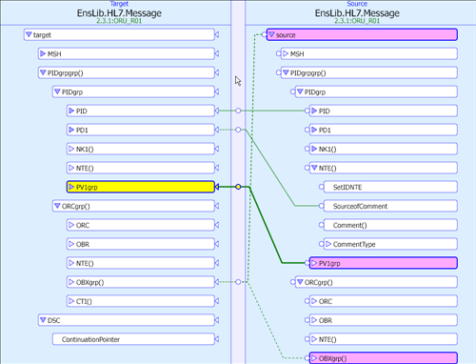
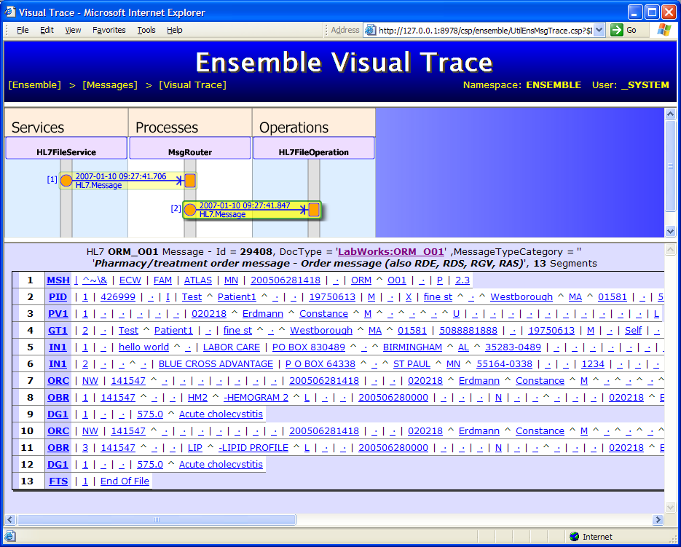
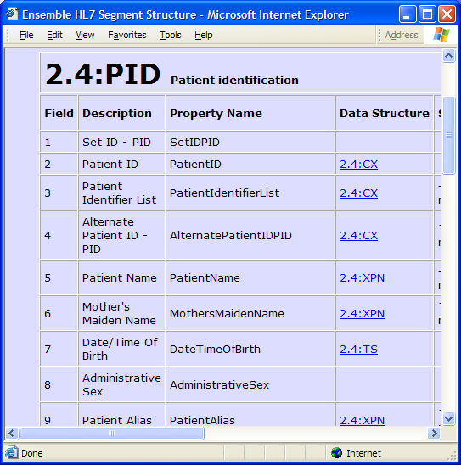
Rapid development of interfaces
Rule based Routing
Graphical Routing and Transformation
Message persistence for easy diagnosis

Slide 19
Ease of Management
Web based management and configuration
Enterprise tools for managing and monitoring multiples instances
Alert generation and Management for unattended operation
Usage and Performance Reports

Slide 20
Secure and Scalable
Secure Enterprise ready platform
Encryption of data in flight and at rest
Runs on all major OS
Supported on VMs and in the cloud
Built in failover and Disaster Recovery
Notes:
Ensemble is used in many mission critical systems in finance, government, healthcare, logistics and other industries.
It has all the capabilities expected of a mission critical system including a range of security options, automated fail over, disaster recovery and backup utiltiies.
We have customers running on many flavors of Unix and Linux, on Windows and OpenVMS. Many customers using virtualization such as VMware and customers have installations in public and private clouds.

Slide 21
Application Orchestration

Slide 22
Application Orchestration
Add pretty picture of application flow here
Integrating data from many applications in real time
Enriching returned results by querying external databases
Merging returned results independent of protocols
Returning consolidated results
Notes:
In many cases a user wants to access data from more than one system, using a mixture of protocols and technologies
Perhaps merging results to provide a consolidated view or a customer’s accounts, or enriching the data by querying a second system to get more details.

Slide 23
Business process Orchestration
Business processes often access many systems
Business Processes include actions taken by people
Business Process Management automates these processes
Add pretty picture of business process here
Notes:
As well as pulling information from many systems, you can automate the interactions with multiple systems over time, emulating a business process.
For example to implement the business process of placing an order, the user may first want to check the inventory for availability and the price list before deciding to place an order, and placing the order may interact with the warehouse application, the billing system and the shipping department. At any stage, the process may have to wait a long time (minutes or hours) for some non-computer process to complete.
Automating processes speeds up processing but more importantly simplifies the user interaction so less expertise is required and it eliminates repeated entry of data and avoids user error.

Slide 24
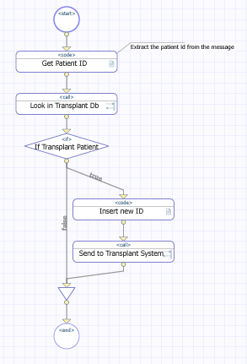
Business process Management
Graphical representation of business processes
Incorporate human workflow
Long running business processes survive system restarts
Not just another scripting language
Notes:
Ensemble BPL provides a graphical editor to define the business process, and to call external application.
But it is more than a graphical scripting language.
The actual business process includes things outside computer applications, such as approval by a manager in a human workflow or physical delivery of materials and can therefore take hours or days to complete.
The BPL saves the state of the business process to disk at each stage and wakes up when a response is received, even if the system bas been restarted, or even upgraded. There is essentially no overhead of having thousands, or even tens of thousands of business process threads in progress at any time.
The role and user based workflow manages task requests and responses for human workflow are managed and available to the user through the user portal

Slide 25
Composite Applications
New user interface
Access to legacy systems
Target high value users
Target mobile users
Notes:
One real use of Business Process Orchestration is to build composite application
Composite applications allow new user interfaces to make use of functionality from existing applications. Often the combine functionality from several legacy systems and present an easy to use interface that supports a small number of tasks. The classic case is a customer kiosk for self registration at a hospital or check in at an airport.
Often the composite application is aimed at customers, or to high value users within the organization.
With the increasing adoption of mobile devices for enterprise applications not just finding a restaurant, the need to provide a simple task oriented UI that knows about the context of a particular work order.

Slide 26
Using Ensemble as an ESB
Notes:
The term ESB is used widely and variously. I have heard almost any form of integration called ESB in RFPs.
Its normal meaning is to handle high volume, simple routing of synchronous requests.
Originally “ESB” was closely linked with Java but now the protocols are predominantly SOAP or REST over http:, but can include any protocol.

Slide 27
Using Ensemble as an ESB
Consumers
Enterprise Service Bus
Providers
Notes:
An Enterprise Service Bus provides a clean isolation between consumers of services and the providers of services

Slide 28
Using Ensemble as an ESB
Governance
Scalability
Robustness
Security
Connectivity
Notes:
An Enterprise Service Bus provides a clean isolation between consumers of services and the providers of services.
The
Ensemble provides highly robust, secure technology that has been at the heart of thousands of mission critical systems. Benchmarks and real life have shown the data platform scaling vertically to support tens of thousands of users in healthcare, vast data insert rates for scientific projects and high speed transaction handling for equity trading in the financial services industry.
Horizontal scaling on premise of in the cloud provides flexibility in scaling.
I’d like to focus for a moment on governance and connectivity

Slide 29
Governance of an Ensemble system
Architectural or Executive Governance
Ensuring the solution follows the business strategy
Development Governance
Ensuring development follows policies
Operational Governance
Ensuring the running system follows policies
Notes:
Governance like security can be difficult to define, but I like to think of it as the wide array of policies, procedures and technologies that allow you stay in control of your world. Ensemble provides a range of functionality that help maintain a well governed system.
For an SOA there are three main types of governance. The architectural governance is really about company policies and procedures and not dependent on the technology of the ESB
Ensuring that development execute on the policies is again largely down to people, but Ensemble’s integration with source control systems, its unit test infrastructure, the service registry and other functionality in the development environment make it easy for developers to do the right thing and to identify when they don’t.
As we move into governance of a running system, technology becomes a bigger part. Now Ensemble’s strong security model, audit trails, alerting mechanisms, throughput and response times dashboards and reports all add up to a complete environment for monitoring and controlling the system.

Slide 30
Service Registry
Registry of all services exposed by Ensemble
Connection data
Service metadata and documentation
REST API for consumers to find services and service information
Registry of all services available to be called from Ensemble
Encourages re-use of services
Improves development governance
Simplifies maintenance of service metadata

Slide 31
Connectivity
Adapter library
Language bindings for Java, C++, etc.
Technology Adapters for TCP/IP, SOAP, REST, FTP, Files, SQL etc.
Protocol Adapters for standards e.g. HL7, EDIFACT, SAP BAPI etc
Connections to other messaging networks e.g. MQ and JMS
Adapters manage the connection
Maintaining connections, Error handling, Retries
Isolate the integration logic from wire protocols
Notes:
All integration patterns start with connectivity. Ensemble provides a library of language bindings and adapters for common technologies such as http:, TCP/IP, FTP, JMS, and MQ as well as protocols such as SOAP, SQL, HL7, X12 etc. or applications like SAP.
As well as dealing with the protocol, the adapters do all the hard work of maintaining connections, retries and error handling.
The adapters isolate the integration logic from the details of the wire protocol, making it easy for the ESB to receive a request in one technology, such as REST and route that as an SQL query to an external database service.

Slide 32
Routing Synchronous Requests with Ensemble
Out of the box routing for REST, SOAP and other protocols
Routing based on http: headers, SOAP headers and message body content
Graphical transformations for XML
High performance parsing of JSON
Embedded data store for high performance and guaranteed delivery
Notes:
The internal message routing supports many standard synchronous and asynchronous exchange patterns, such as content and rule based routing, pub/sub, WS-Addressing and so on.
Graphical tools make it easy to establish connections, convert data from one format to another, to orchestrate calls to external applications and to define business rules.
The built in high performance database plays two important roles. First it means that messages and queues are persistent and can survive system restarts. This means message delivery can be guaranteed and the context of a long running workflow can be maintained.
This also means that messages can be traced after the event for diagnosing problems and even resending messages if downstream applications fail for some reason.
The second important role is to store data extracted from messages. This allows the data to be used in many ways, especially as source data for Ensemble’s built in real time analytics. This gives real time insight into the state of your business by driving dashboards, or more interestingly triggering events and business processes that can act on the information, not just wait for a person to respond.
Governance and management of an integration platform can be challenging. Ensemble provides an advanced web based management system to monitor and control the entire platform.

Slide 34
Ensemble
Data Coordination
Business Process
/ Work Flow
Composite Applications
Business Activity Monitoring
Universal Business Integration Platform
Data
Application
Technology

Slide 35
Bulleted List / 22pt / use triangle
Second level
Third level
Fourth level
Fifth level

Slide 36
Customer Use Cases

Slide 37
Spare slides
Slide Divider Subtitle

Slide 38
Data Platform for Strategic Integration
Adapters for connectivity
Synchronous and asynchronous message patterns
Rule based routing
Orchestration of business processes
Graphical tools for high productivity
Embedded data store for high performance and guaranteed delivery
Governance and advanced system management
Scalable and robust
Notes:
The internal message routing supports many standard synchronous and asynchronous exchange patterns, such as content and rule based routing, pub/sub, WS-Addressing and so on.
Graphical tools make it easy to establish connections, convert data from one format to another, to orchestrate calls to external applications and to define business rules.
The built in high performance database plays two important roles. First it means that messages and queues are persistent and can survive system restarts. This means message delivery can be guaranteed and the context of a long running workflow can be maintained.
This also means that messages can be traced after the event for diagnosing problems and even resending messages if downstream applications fail for some reason.
The second important role is to store data extracted from messages. This allows the data to be used in many ways, especially as source data for Ensemble’s built in real time analytics. This gives real time insight into the state of your business by driving dashboards, or more interestingly triggering events and business processes that can act on the information, not just wait for a person to respond.
Governance and management of an integration platform can be challenging. Ensemble provides an advanced web based management system to monitor and control the entire platform.

Slide 39
Data Integration
Exchange of data between applications
Store and Forward – guaranteed delivery
Single transactions or batch files
Interface Engine is the hub
Messaging and batch file processing
X12, EDIFACT, HL7, DICOM, ASTM, XML
TCP, file, http:, MQ, JMS, XML, JSON
Synchronous requests
WS-*, SOAP, REST
Critical resource to the whole enterprise
Connection to existing enterprise message networks such as JMS or MQ
Notes:
<note: this is not intended for an audience who are looking for an HL7 engine, this slide would be too introductory>
Data integration allows applications that run independently to exchange information. Different industries have different protocols, and obviously you are most familiar with <insert relevant protocol >.
Most organizations use a combination of real time messaging and managed file transfers.
Some message protocols such as JMS or MQ focus just on the communication by others are more concerned with the content.
But in either case, the interface engine or message broker becomes the critical connection between these applications.

Slide 40
Ensemble Architecture
Objects
Single Development Environment
SQL
Projections
Metadata Repository
Web Serv
Data
Transformation Engine
Rules Engine
Workflow Engine
Data
Apps
Apps
Business Service
Business Process
Business Operation
Adapters
Adapters
Tech
Custom
Tech
Messaging Engine
Dashboards
Custom
Message Warehouse
Alerts
Metrics
Custom
End-to-End Management Portal
Notes:
40

Slide 41
Ensemble Architecture
Objects
Single Development Environment
SQL
Projections
Metadata Repository
Web Serv
Data
Transformation Engine
Rules Engine
Workflow Engine
Data
Apps
Apps
Inbound Interfaces
Business Logic
Outbound Interface
Adapters
Adapters
Tech
Custom
Tech
Messaging Engine
Dashboards
Custom
Message Warehouse
Alerts
Metrics
Custom
End-to-End Management Portal
Notes:
41

Slide 42
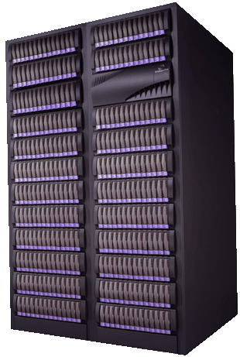
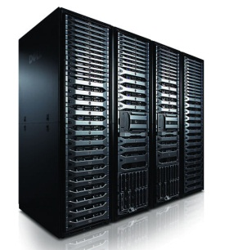

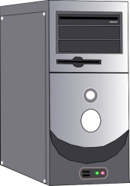



Interação Humana com Workflows
Ensemble
Business
Operation
(Invoker)
Outbound Adapter
Business Process
?
Business
Operation
(Invoker)
Call
Call
Call
Business Service
(Dispatcher)
Inbound Adapter
Wait
Business
Operation
(Invoker)
Outbound Adapter
Loop
If…
Business
Operation
(Invoker)
Call
Trace
Outbound Adapter
!

Slide 43
Color Palette
This is the standard palette for the template which is used as the default for charts and graphics.

